Slide 1
Global E-commerce Website Dashboard Shivani Patel
Tableau Desktop Portfolio

Slide 2


Fundamentals of Tableau Desktop
Utilized FUNDAMENTALS OF TABLEAU DESKTOP TO CREATE DATA VISUALIZATION DASHBOARD AND STORY
please REFER TO ATTACHED DATA SET UTILIZED FOR THIS PROJECT
fundamental FEATURES listed AS FOLLOWS: CONNECTING TO DATA, joins AND DATA PREPARATION, CONNECTING LIVE VERSUS EXTRACTING, DIMENSIONS AND MEASURES, BUILDING VIEWS, QUICK TABLE CALCULATIONS, CROSSTAB AND EXPORTING DATA, SHOW ME, CUSTOM TERRITORIES, FILTERS, BAR CHART, HIERARCHIES, SORTING, GROUPING, WORKING WITH MARKS, TREND LINES, DASHBOARDS, STORY POINTS
The dashboard highlights key features driving the business of global superstore. It highlights areas contributing to global sales and profit.
The dashboard also shows breakdown of shipping cost over profit sales to show average profitable shipping cost for thriving business.

Slide 3
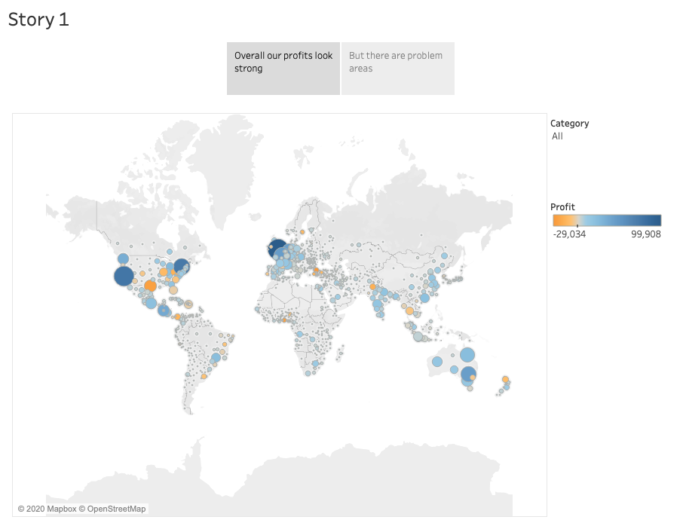

Slide 4
